Slide 1
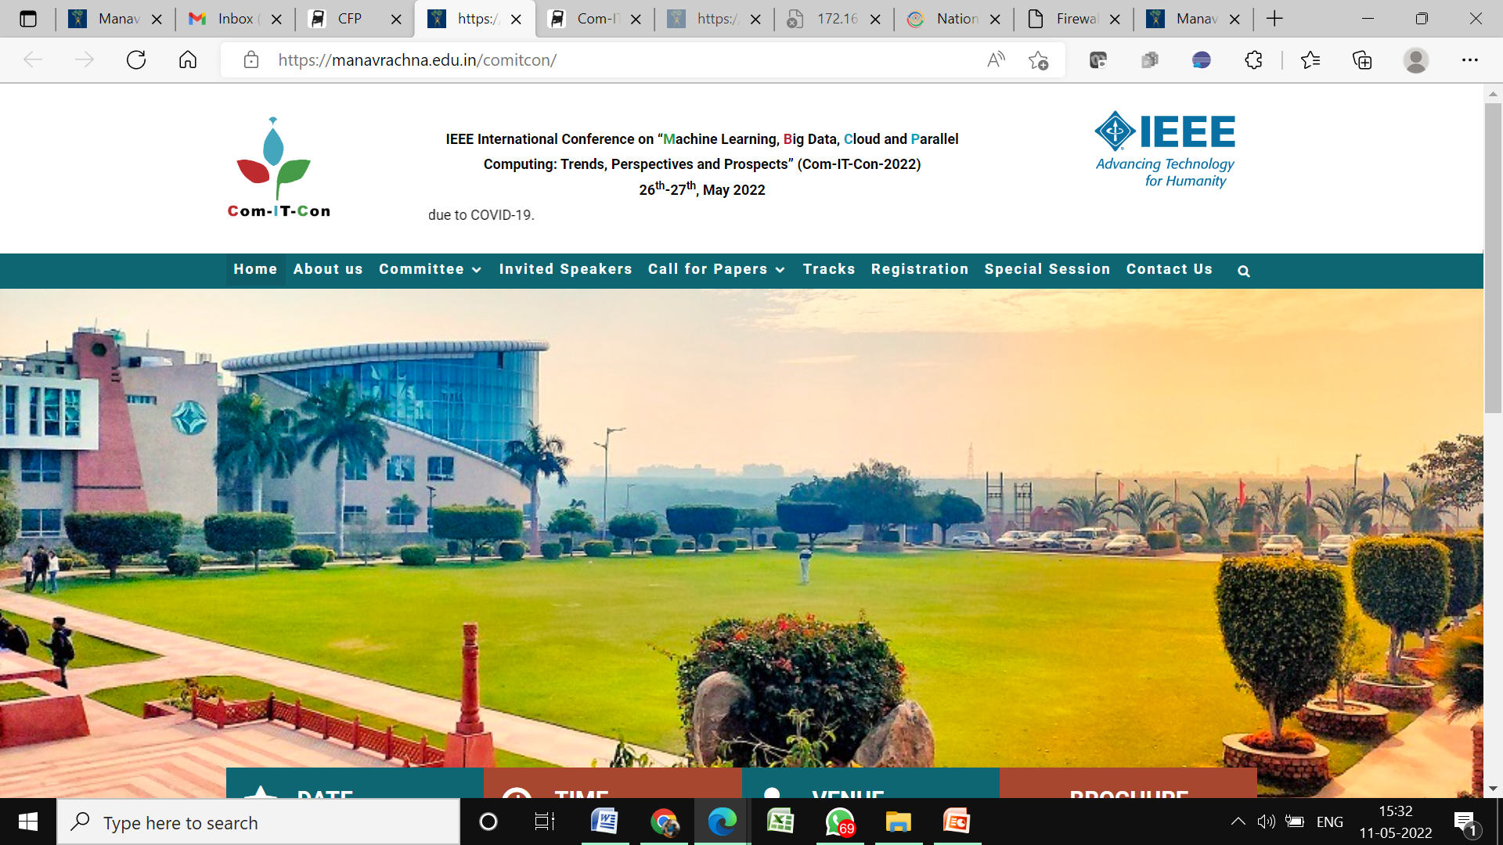

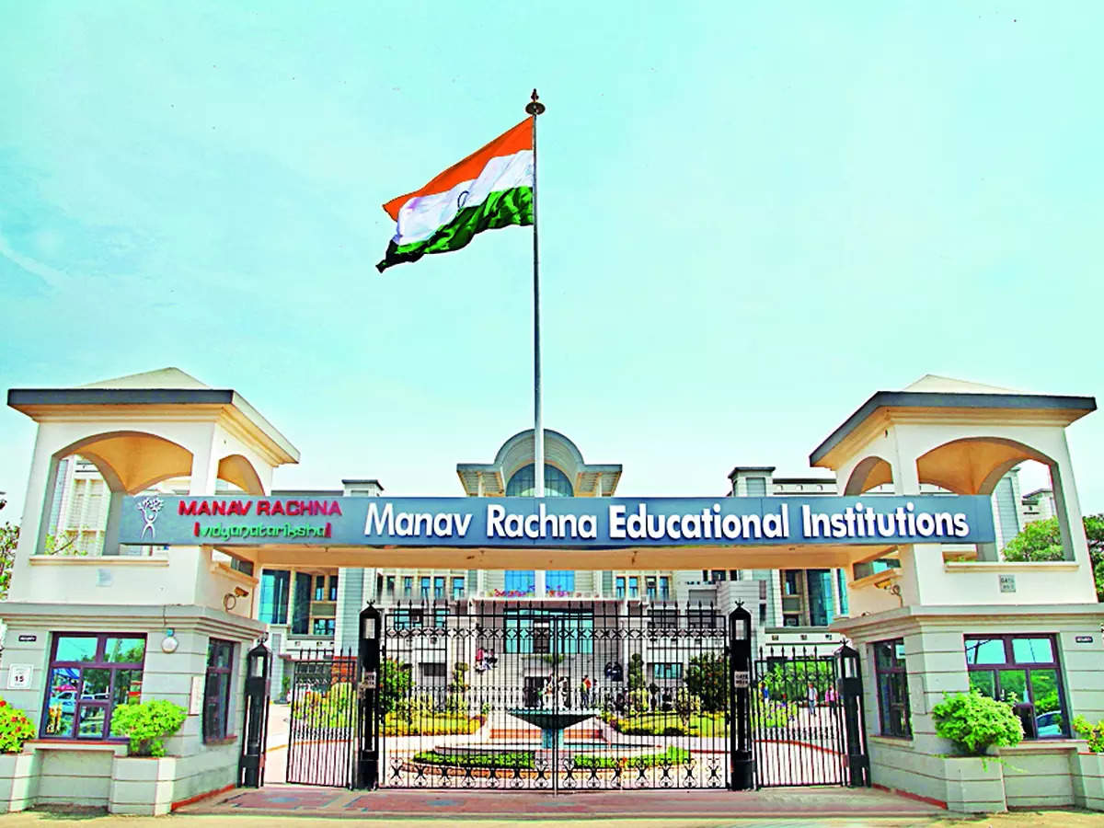
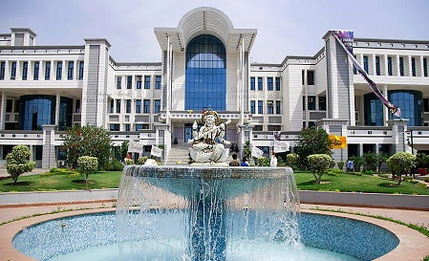
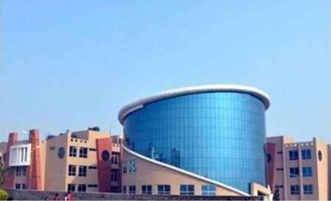
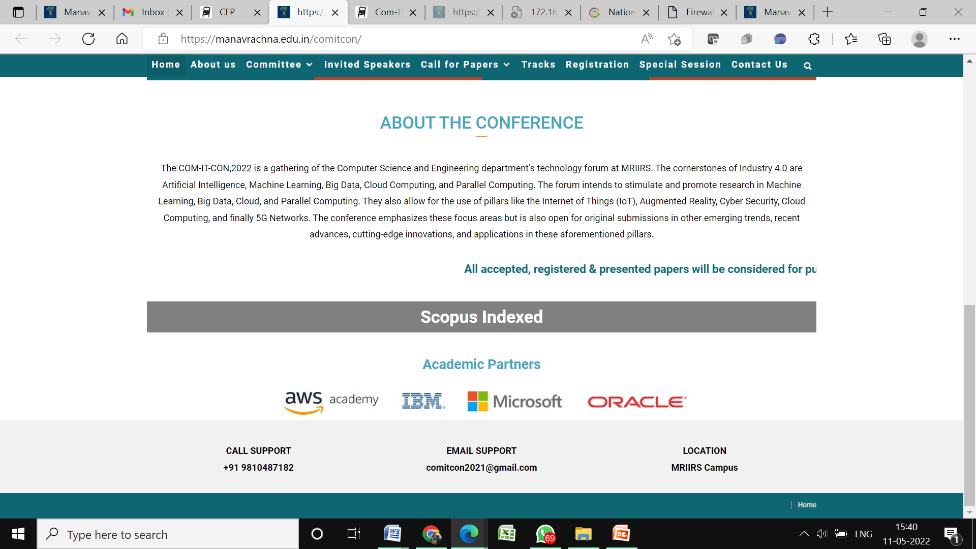


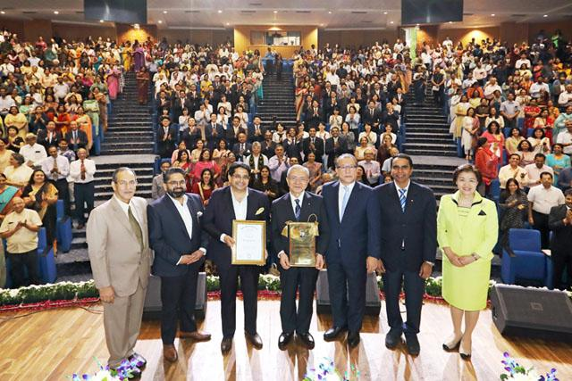
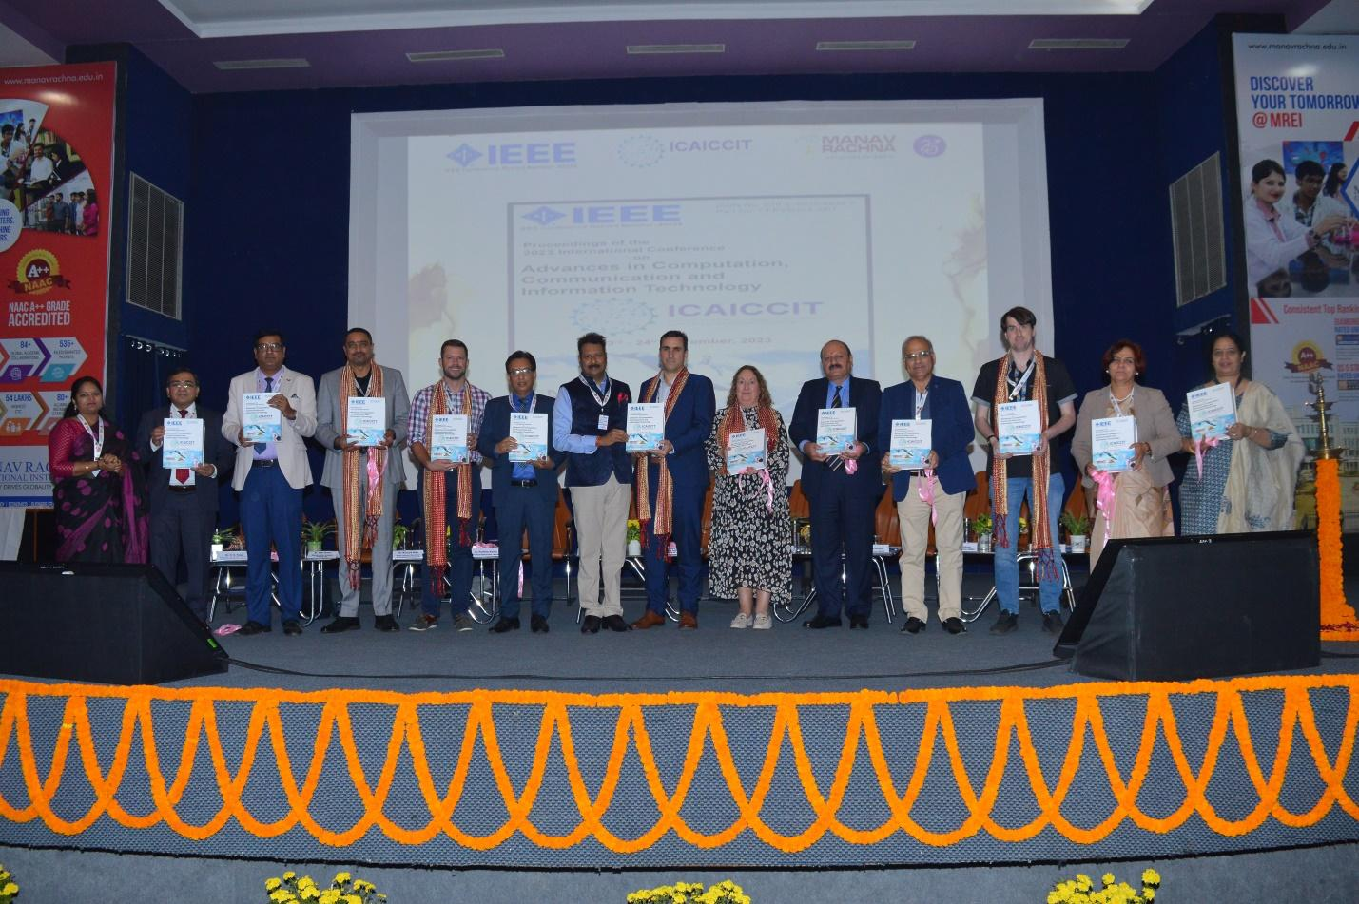
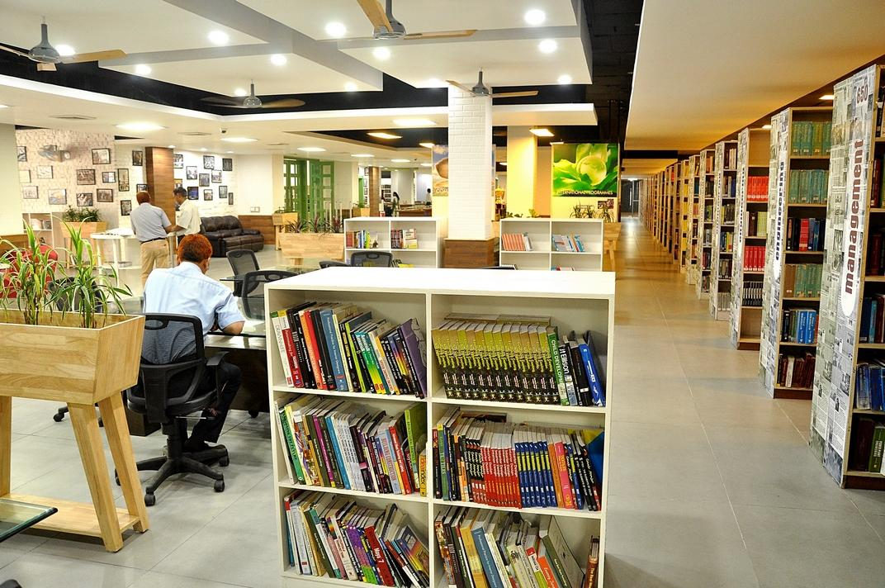
ICAICCIT-2025, 3rd International conference on Advances in Computing,
Communication and Information Technology
technically Co-Sponsored by IEEE Delhi
(IEEE record no # 68829)
on 31st Oct & 1st Nov. 2025

Slide 2
YOLO-HF: A Compact System for Fire Detection and Alerting
ICAICCIT_0396
Yaswanth Gunda, Ranjith Kumar Garikapati, Bala Muneendra Chilaka, Tarun Bellamkonda, Sampath Kumar Madanu, Sireesha Moturi.
Narasaraopeta Engineering College
Satish Kumar Garigipati.
Gokaraju Gangaraju Institute of Engineering and Technology
Presented By
Yaswanth Gunda
Academic Partners

Slide 3
INTRODUCTION
Fire incidents seriously affect life, property, and environment.
India (2022): 27K+ fires, 18K deaths.
Traditional systems → slow, limited, many false alarms.
YOLO-HF: compact YOLOv5s with PBCA, SPD, CBPS, RepNCSPELAN4.
Improves fire & smoke detection accuracy and speed.
Adds real-time alerts via email & Twilio calls.
Academic Partners

Slide 4
PROBLEM STATEMENT
Fire incidents cause huge loss of life, property, and environment.
Traditional sensors are often slow and produce false alarms in complex areas.
Existing detection systems have limited coverage and delayed response.
Even lightweight deep learning models struggle to detect irregular flames and smoke patterns accurately.
There is a need for a fast, reliable, and accurate system for early fire and smoke detection in real-world environments.
Academic Partners

Slide 5
OBJECTIVES
To enable early and accurate detection of fire and smoke in real-world conditions.
To reduce false alarms and improve response time compared to traditional systems.
To create a compact and efficient detection model suitable for practical environments.
To support real-time monitoring for homes, industries, and forest areas.
To ensure reliable alerts that help prevent major loss of life and property.
Academic Partners

Slide 6
LITERATURE REVIEW
Many works used YOLO models for fire and smoke detection.
They improved speed, accuracy, and real-time use.
Some used attention layers or feature fusion for better results.
A few tried sound-based or lightweight models.
But most still have problems like:
Low-light and smoke issues No real-time alert system
Not fit for low-power devices Miss early smoke signs
Academic Partners

Slide 7
METHODOLOGY
YOLO-HF is built on YOLOv5s with added modules for better fire and smoke detection.
Designed to handle faint smoke, low light, and small or distant fires.
Trained using Google Colab (Tesla T4 GPU, PyTorch, CUDA).
Tested on HP Victus laptop using webcam and DroidCam for live feed.
Alert system tested with email and Twilio voice calls.
Used a dataset of 6,500 fire/smoke images (train: 3900, val: 1300, test: 1300).
Images resized to 640×640 for YOLO format.
Academic Partners

Slide 8
RESULT & DISCUSSION
YOLO-HF outperforms YOLOv5s and other recent models (YOLOv8, YOLOv9-CBM, FDN, GSF-YOLOv8).
Metrics: Precision = 0.937, Recall = 0.914, mAP@0.5 = 0.923.
False alarms reduced using:
Confidence threshold tuning
Non-Maximum Suppression (NMS) adjustments
PR curve shows strong precision-recall balance.
Qualitative results: Accurate detection in indoor/outdoor, distant, and partially occluded fire/smoke scenes.
Academic Partners

Slide 9
CONCLUSION & FUTURE SCOPE
Conclusion:
YOLO-HF is fast and accurate for fire detection.
Works in real-time with email & Twilio alerts.
Limitations:
Tested on limited datasets.
Struggles in low light, heavy smoke, or reflections.
Only uses RGB input.
Future Scope:
Test on bigger and diverse datasets.
Add thermal or IoT sensors.
Deploy on drones for wildfire monitoring.
Make lighter models for edge devices.
Academic Partners

Slide 10
REFERENCES
NCRB, “Accidental deaths & suicides in India 2022,” 2023.
B. Peng & T.-K. Kim, “YOLO-HF,” 2025; L. Shang et al., “YOLO-DKM,” 2025.
M. Sun & C. Liu, “Acoustic fire detection,” 2025; Z. Xue et al., “YOLOv11 improvements,” 2025.
X. Geng et al., “YOLOv9-CBM,” 2025; C. Li et al., “GSF-YOLOv8,” 2025.
J. Liang & J. Cheng, “Mirror Target YOLO,” 2025; W.-T. Sung et al., “GhostNet fire detection,” 2025.
D. H. Shin et al., “FDN,” 2025; G. M. I. Alam et al., “FireNet-CNN,” 2025.
Academic Partners

